Slide 1

The Technology that Changed the World:
How Technology Impacts People in the United States, Both Negatively and Positively
Group Members:
Matthew Bartley, Justin Butler, Chloe Collins, Patrick Glover, Timisha Martin, Sonal Panchal, George Pasley, Anna Phimmasone, Mohammad Sami, Jason Tan

Slide 2
Project Hypothesis:
The growth of technology in the 21st century, including social media, cell phones and video games, has radically impacted people of all ages in the United States both positively and negatively.
How has technology impacted:
…the obesity rate in young people?
…education in American youth?
…the overall crime rate?
…the employment rate in America?
…outdoor activity and sports participation among young people?

Slide 3
Why We Asked the Questions We Asked:
We chose to ask our questions for various reasons:
Some of us, as parents, are very interested in the impact technology has on children and teens.
We all, as students of data analytics, are interested in technology’s impact on the employment rate.
We all, as citizens of this country and state, are interested in the impact technology has on the crime rate.

Slide 4
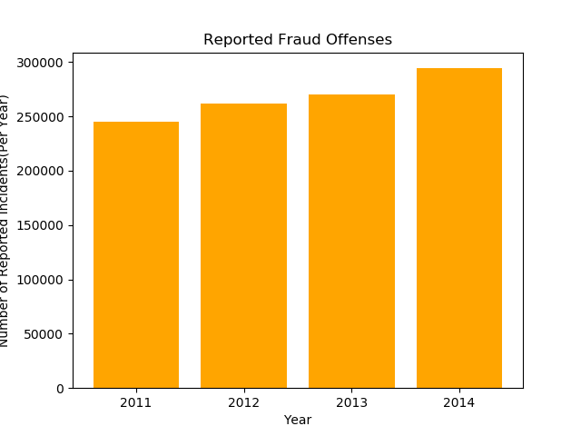


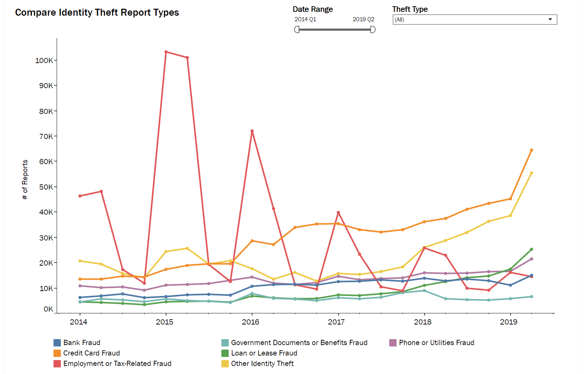
Technology’s impact on the crime rate:

Slide 5
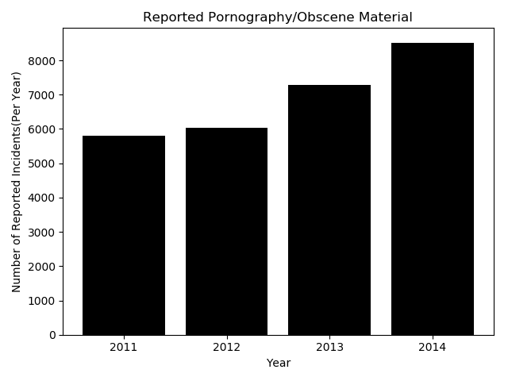
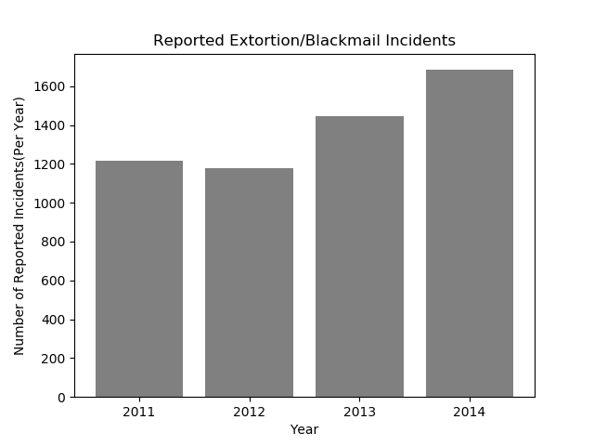

…Crime rate continued.

Slide 6
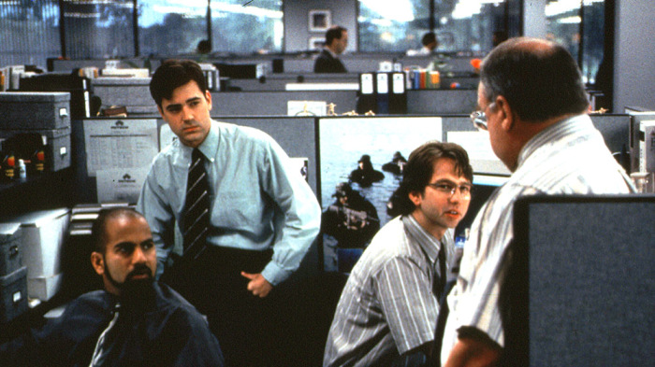
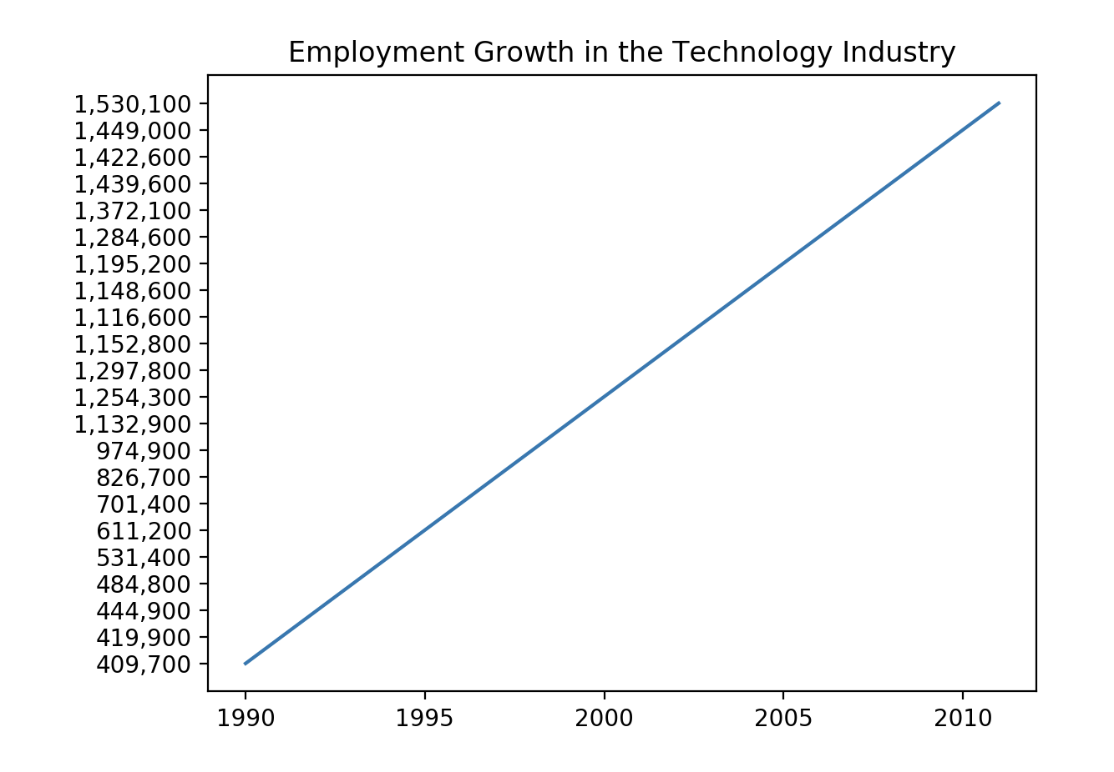
Technology’s impact employment:

Slide 7
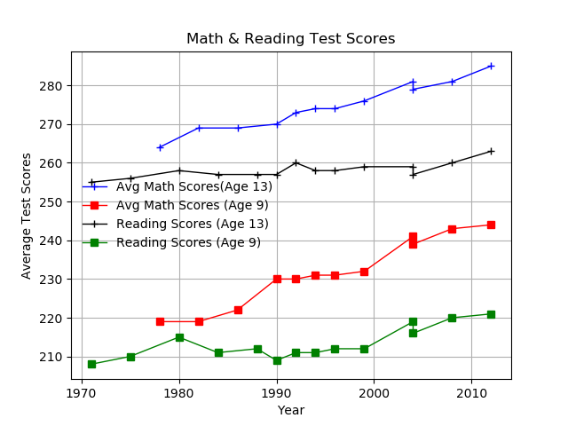

Technology’s impact on education:

Slide 8
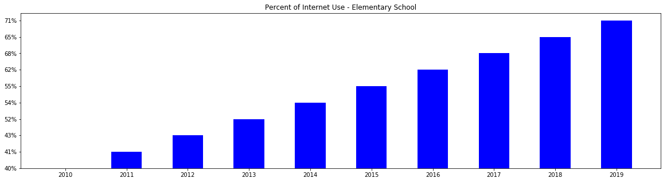
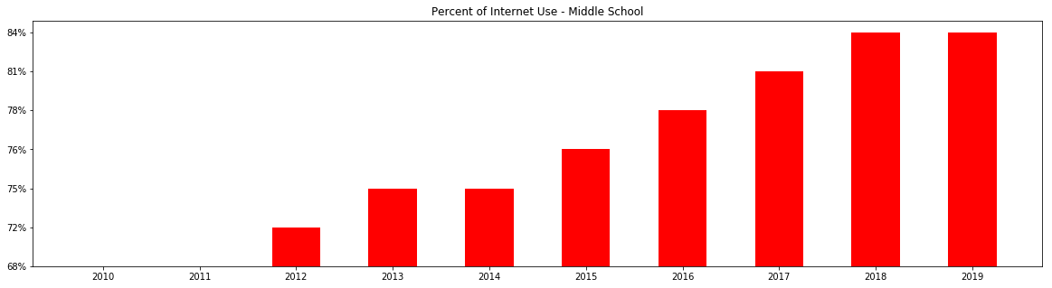
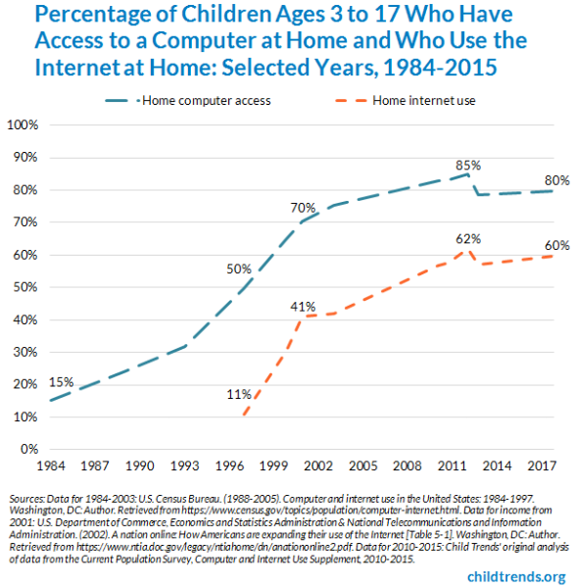
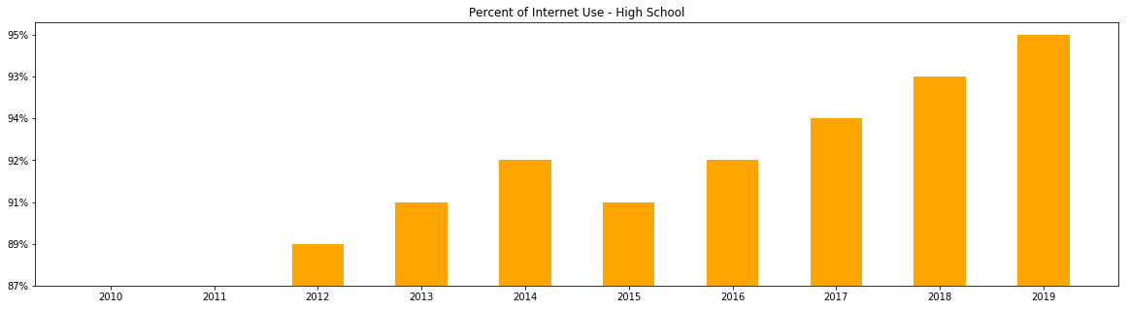
…Education continued
Computer and internet access at home from 1984 to 2015

Slide 9

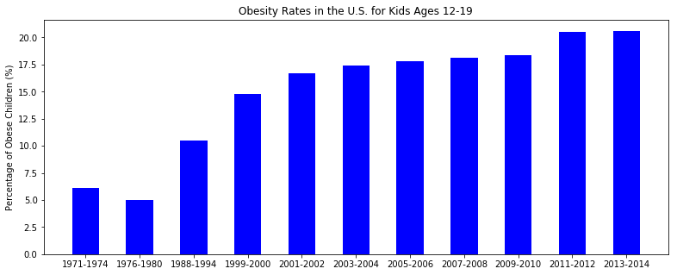
Technology’s impact on young people:

Slide 10
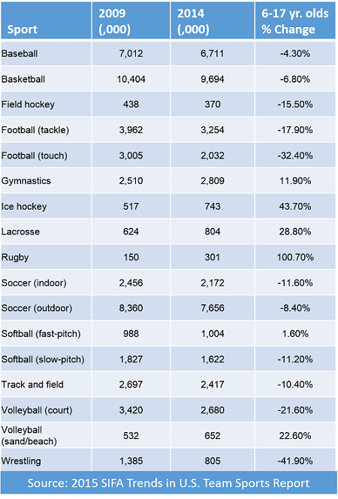
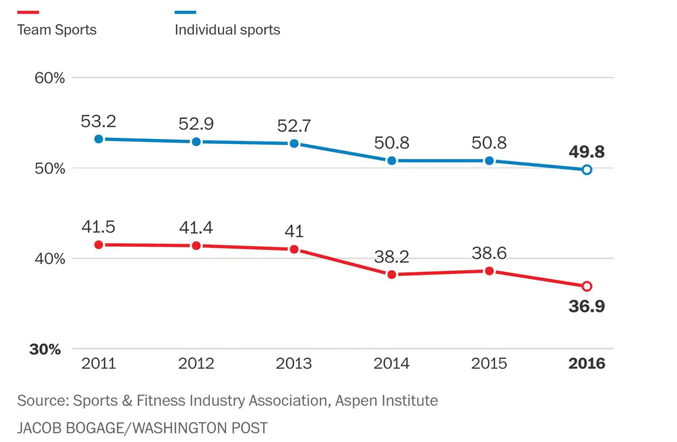
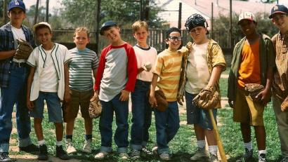
Technology’s impact on sports participation:

